Slide 1
Advanced Software Programming
ITMD 415/515
Time: Tuesday/Thursday 3:15 pm to 4:30 pm
Room: Robert A. Pritzker Science Ctr 121
Instructor: Omar Aldawud
TA: TBD

Slide 2
Text Book: Beginning Java EE 7 -
Java EE 7 consists of nearly 30 specifications and is an important milestone:
  for the enterprise layer
    CDI 1.1, Bean Validation 1.1, EJB 3.2, JPA 2.1
  for the web tier
    Servlet 3.1, JSF 2.2, Expression Language 3.0
  and for interoperability
    JAX-WS 2.3 and JAX-RS 2.0
This book covers a broad part of the Java EE 7
  specifications and uses the JDK 1.7 and
  some well-known design patterns, as well as
  the GlassFish application server,
  the Derby database,
  JUnit, and Maven.
  It is illustrated abundantly with UML diagrams and Java code.

Slide 3

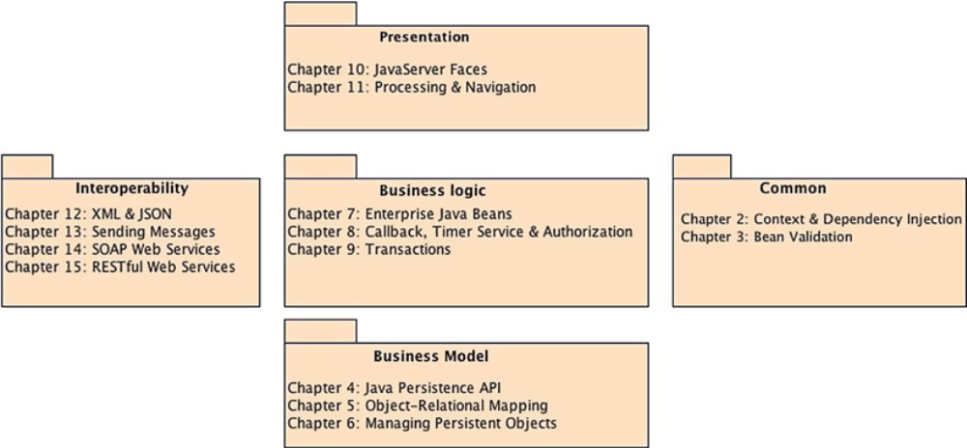
Class Structure

Slide 4
JEE
Introduction

Slide 5
Java EE Introduction
Java EE is a set of specifications intended for enterprise applications. It can be seen as an extension of Java SE to facilitate the development of distributed, robust, powerful, and highly available applications
JAVA SE API
  Name some frameworks in Java SE
JAVA EE API
  Name some frameworks in Java SE

Slide 6
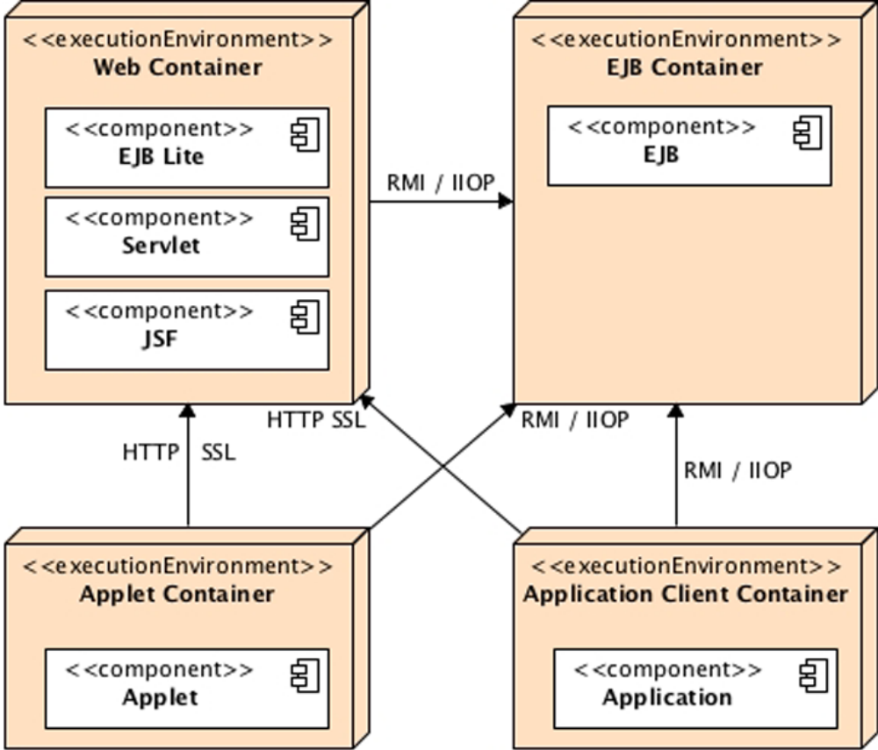
JEE Architecture
Containers are Java EE runtime environments
Standard Java EE containers

Slide 7
Web Container
A web container
  also known as a servlet container
  is the component of a web server that interacts with Java servlets.
  A web container is responsible for managing the lifecycle of servlets, mapping a URL to a particular servlet and ensuring that the URL requester has the correct access-rights.
A web container
  handles requests to servlets, JavaServer Pages (JSP) files, and other types of files that include server-side code.
  The Web container creates servlet instances, loads and unloads servlets, creates and manages request and response objects, and performs other servlet-management tasks.

Slide 8
Servlet Containers
Open Source Web Containers
Commercial Web Containers
Apache Tomcat (formerly Jakarta Tomcat) is an open source web container
Apache Geronimo is a full Java EE 6 implementation by Apache Software Foundation.
Enhydra, from Lutris Technologies.
GlassFish from Oracle (an Application Server, but includes a web container).
JBoss Application Server (now WildFly) is a full Java EE implementation by Red Hat Inc., division JBoss.
Jetty, from the Eclipse Foundation. Also supports SPDY and WebSocket protocols.
Jaminid contains a higher abstraction than servlets.
Payara is another Application Server, derived from Glassfish.
…
iPlanet Web Server, from Oracle.
JBoss Enterprise Application Platform from Red Hat Inc
JRun, from Adobe Systems
WebLogic Application Server, from Oracle Corporation
Orion Application Server, from IronFlare.
Resin Pro, from Caucho Technology.
ServletExec, from New Atlanta Communications.
IBM WebSphere Application Server.
SAP NetWeaver.
…

Slide 9
Java Platform, Enterprise Edition -Java EE
is a computing platform for development and deployment of enterprise software (network and web services).
The platform uses the object-oriented Java programming language
Java EE extends the Java Platform, Standard Edition (Java SE) providing an API for:
  object-relational mapping (ORM)
  distributed and multitier architectures, and
  web services.
  And more …

Slide 10
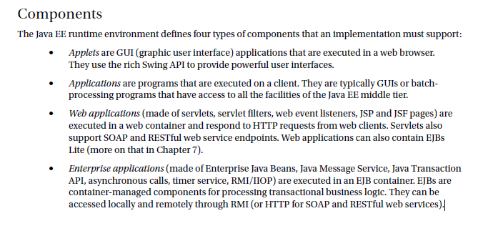
Components
From book:

Slide 12
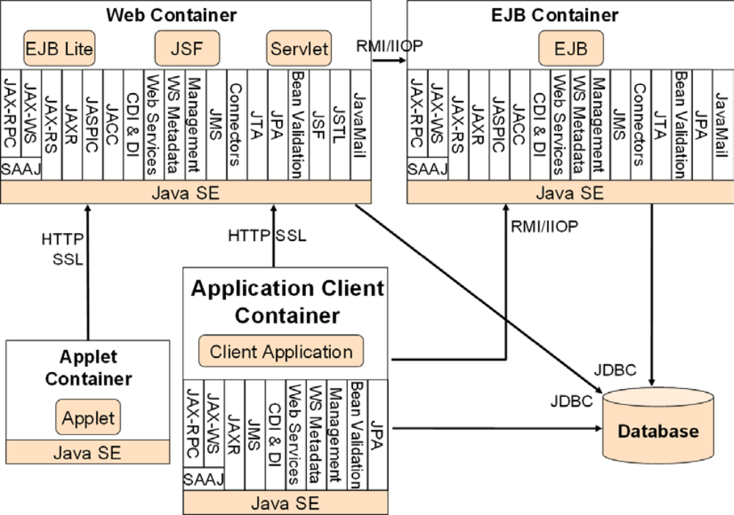
Services provided by containers

Slide 13
Network Protocols
HTTP
  HTTP is the Web protocol and is ubiquitous in modern applications. The client-side API is defined by the java.net package in Java SE.
  The HTTP server-side API is defined by servlets, JSPs, and JSF interfaces, as well as SOAP and RESTful web services.
HTTPS
  is a combination of HTTP and the Secure Sockets Layer (SSL) protocol.
RMI-IIOP: Remote Method Invocation (RMI) allows you to invoke remote objects independently of the underlying protocol.
  The Java SE native RMI protocol is Java Remote Method Protocol (JRMP).
  RMI-IIOP is an extension of RMI used to integrate with CORBA.

Slide 14
Annotations & Deployment Descriptors
In programming paradigm, there are two approaches: imperative programming and declarative programming.
  Imperative programming specifies the algorithm to achieve a goal (what has to be done), whereas
  Declarative programming specifies how to achieve this goal (how it has to be done).
In Java EE, declarative programming is done by using metadata:
  annotations or/and
  deployment descriptors (DD)
    A deployment descriptor refers to an XML configuration file that is deployed with the component in the container.

Slide 15
EJB with Annotations
EJB Deployment Descriptor
@Stateless
@Remote(ItemRemote.class)
@Local(ItemLocal.class)
@LocalBean
public class ItemEJB implements ItemLocal, ItemRemote {
  @PersistenceContext(unitName = "chapter01PU")
  private EntityManager em;
  public Book findBookById(Long id) {
  return em.find(Book.class, id);
  }
}
<ejb-jar xmlns="http://xmlns.jcp.org/xml/ns/javaee" xmlns:xsi="http://www.w3.org/2001/XMLSchema-instance" xsi:schemaLocation="http://xmlns.jcp.org/xml/ns/javaee
http://xmlns.jcp.org/xml/ns/javaee/ejb-jar_3_2.xsd" version="3.2">
  <enterprise-beans>
    <session>
      <ejb-name>ItemEJB</ejb-name>
      <remote>org.agoncal.book.javaee7.ItemRemote</remote>
      <local>org.agoncal.book.javaee7.ItemLocal</local>
      <local-bean/>
      <ejb-class>org.agoncal.book.javaee7.ItemEJB</ejb-class>
      <session-type>Stateless</session-type>
      <transaction-type>Container</transaction-type>
    </session>
  </enterprise-beans>
</ejb-jar>

Slide 16
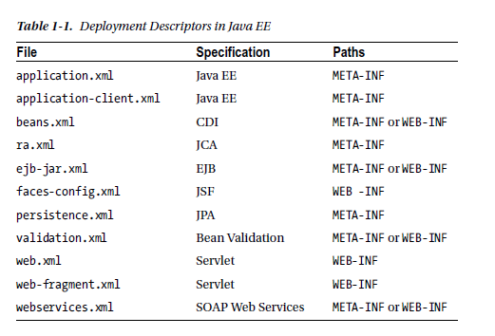
Deployment Descriptors in Java EE

Slide 17
JEE Specification
Table 1-2. Java EE Spec JSR URL
Java EE 7.0 342 http://jcp.org/en/jsr/detail?id=342
Web Profile 7.0 342 http://jcp.org/en/jsr/detail?id=342
Managed Beans 1.0 316 http://jcp.org/en/jsr/detail?id=316
Table 1-3. Web Services Specifications
JAX-WS 2.2a 224 http://jcp.org/en/jsr/detail?id=224
JAXB 2.2 222 http://jcp.org/en/jsr/detail?id=222
Web Services 1.3 109 http://jcp.org/en/jsr/detail?id=109
Web Services Metadata 2.1 181 http://jcp.org/en/jsr/detail?id=181
JAX-RS 2.0 339 http://jcp.org/en/jsr/detail?id=339
JSON-P 1.0 353 http://jcp.org/en/jsr/detail?id=353
Table 1-4. Web Specifications JSR URL
JSP 2.3 245 http://jcp.org/en/jsr/detail?id=245
JSTL (JSP Standard Tag Library) 52 http://jcp.org/en/jsr/detail?id=52
Servlet 3.1 340 http://jcp.org/en/jsr/detail?id=340
WebSocket 1.0 356 http://jcp.org/en/jsr/detail?id=356

Slide 18
Java EE Versions
The platform was known as Java 2 Platform, Enterprise Edition or J2EE from version 1.2, until the name was changed to Java Platform, Enterprise Edition or Java EE in version 1.5.
  J2EE 1.2 (December 12, 1999)
  J2EE 1.3 (September 24, 2001)
  J2EE 1.4 (November 11, 2003)
  Java EE 5 (May 11, 2006)
  Java EE 6 (December 10, 2009)
  Java EE 7 (May 28, 2013)
  Java EE 8 (expected by the end of 2017) Current

Slide 19
Java EE Application Server
The platform incorporates a design based largely on modular components running on an application server
An application server is:
  a software framework that provides both facilities to create web applications and a server environment to run them.
In Java application servers:
  the server behaves like an extended virtual machine for running applications, transparently handling connections to the database on one side, and, often, connections to the Web client on the other.
  Java Platform, Enterprise Edition or Java EE (was J2EE) defines the core set of API and features of Java Application Servers.
  The Web modules include Servlets and JavaServer Pages.
  Enterprise JavaBeans (EJB) are used to manage transactions.

Slide 20
.NET Framework Application Server
Microsoft positions their middle-tier applications and services infrastructure in the Windows Server operating system and the .NET Framework technologies in the role of an application server.
The Windows Application Server role includes:
  Internet Information Services (IIS) to provide web server support,
  the .NET Framework to provide application support,
  ASP.NET to provide server side scripting
Third-party .NET APP Server
  Mono (a cross platform open-source implementation of .NET supporting nearly all its features, with the exception of Windows OS-specific features), sponsored by Novell, Inc., licensed under GPL
  Base4 Application Server, an open source project
  TNAPS Application Server, freeware application server, developed by TN LLC

Slide 21
JDBC, ORM, JPA

Slide 22
JDBC

Slide 23
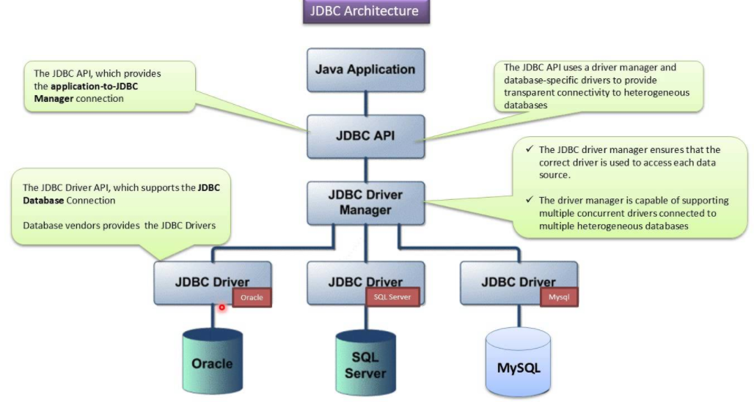
What is JDBC?
JDBC stands for Java Database Connectivity and provides a set of Java API for accessing the relational databases from Java program.
  These Java APIs enables Java programs to execute SQL statements and interact with any SQL compliant database.

Slide 24
Example 1/2
public class Employee {
private int id;
private String first_name;
private String last_name;
private int salary;
public Employee() {}
public Employee(String fname, String lname, int salary) {
this.first_name = fname; this.last_name = lname; this.salary = salary;
}
public int getId() { return id; }
public String getFirstName() { return first_name; }
public String getLastName() { return last_name; }
public int getSalary() { return salary; }
}
create table EMPLOYEE (
id INT NOT NULL auto_increment,
first_name VARCHAR(20) default NULL,
last_name VARCHAR(20) default NULL,
salary INT default NULL,
PRIMARY KEY (id)
);

Slide 25
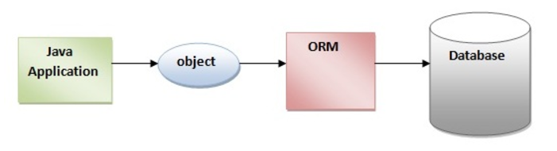
ORM
An ORM tool simplifies the data creation, data manipulation and data access. It is a programming technique that maps the object to the data stored in the database.
JDBC is the API for database access, and it works "in a relational way" - you query tables and get rows and columns back. Hibernate uses JDBC under the hood to fetch the data and later convert it to objects.
    In hibernate this becomes of List<SomeClass> where SomeClass has a field for every column in the database table, and there is one instance ofSomeClass` per database record.

Slide 26
Problem with Mapping
what if we need to modify the design of our database after having developed few pages or our application?
Loading and storing objects in a relational database exposes us to the following five mismatch problems:
Mismatch | Description
Granularity | Sometimes you will have an object model which has more classes than the number of corresponding tables in the database.
Inheritance | RDBMSs do not define anything similar to Inheritance which is a natural paradigm in object-oriented programming languages.
Identity | A RDBMS defines exactly one notion of 'sameness': the primary key. Java, however, defines both object identity (a==b) and object equality (a.equals(b)).
Associations | Object-oriented languages represent associations using object references where as am RDBMS represents an association as a foreign key column.
Navigation | The ways you access objects in Java and in a RDBMS are fundamentally different.
The Object-Relational Mapping (ORM) is the solution
Notes:
Source: https://www.tutorialspoint.com/hibernate/orm_overview.htm

Slide 27
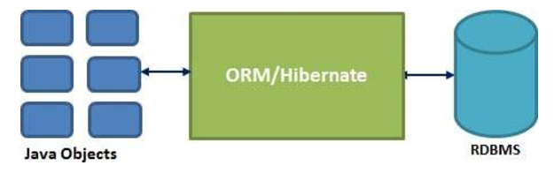
Java ORM Frameworks:
There are several persistent frameworks and ORM options in Java. A persistent framework is an ORM service that stores and retrieves objects into a relational database.
  Enterprise JavaBeans Entity Beans
  Java Data Objects
  Castor
  TopLink
  Spring DAO
  Hibernate

Slide 28
ORM
ORM allows you to use java objects as representation of a relational database. It maps the two concepts (object-oriented and relational)
  Hibernate is an ORM framework - you describe how your objects are represented in your database, and hibernate handles the conversion.
    A JDBC ResultSet has multiple records, and each record has a set of columns.
    supports a query language that can express complex queries involving joins
      translates queries into SQL queries
    allows relationships to be mapped to sets associated with objects
      e.g. courses taken by a student can be a set in Student object

Slide 29
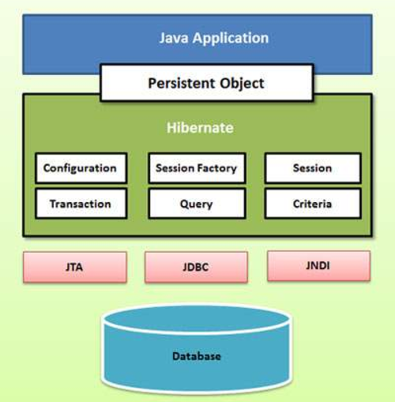
ORM - Hibernate
Hibernate uses various existing Java APIs:
  JDBC,
  Java Transaction API(JTA), and
  Java Naming and Directory Interface (JNDI).

Slide 30
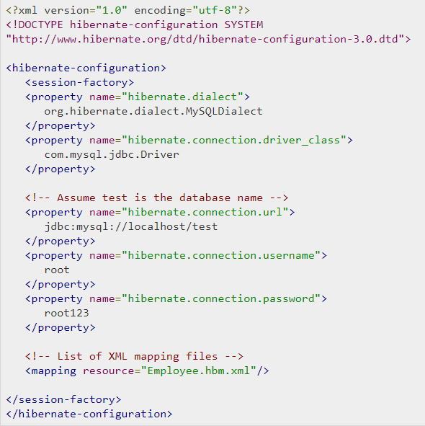
Example: Hibernate with MySQL Database
hibernate.cfg.xml
configuration file

Slide 31
Advantages of Hibernate
Opensource and Lightweight
Fast performance: The performance of hibernate framework is fast because cache is internally used in hibernate framework.
  There are two types of cache in hibernate framework first level cache and second level cache.
Database Independent Query: HQL (Hibernate Query Language)
  is the object-oriented version of SQL.
  It generates the database independent queries.
    So you don't need to write database specific queries. Before Hibernate, If database is changed for the project, we need to change the SQL query as well that leads to the maintenance problem.
Automatic Table Creation:
  Hibernate framework provides the facility to create the tables of the database automatically.
Simplifies Complex Join
  To fetch data form multiple tables is easy in hibernate framework.
Provides query statistics and database status:
  Hibernate supports Query cache and provide statistics about query and database status.

Slide 32
Next Time
Application Architecture

